Slide 1




Spectral Analysis of Solar-type Stars
Collin Lewin, University of Arizona
Ellen Howell, OSIRIS-REx Data Science Team

Slide 2
Absorption Spectrum Overview
Spectrum: Light emitted over a range of wavelengths
When light reflects off an asteroid:
  Specific wavelengths are absorbed, the rest are reflected
  Can deduce the surface compounds from which wavelengths are absorbed

Slide 3
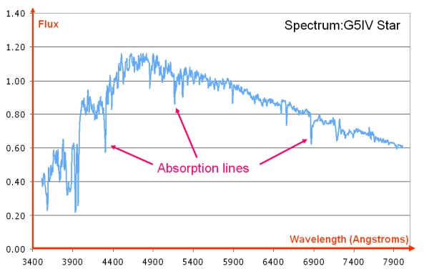
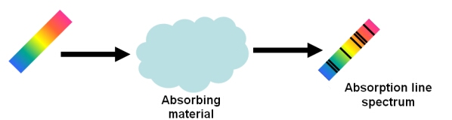
Visualizing Spectral Absorption
Source: COSMOS – The SAO Encyclopedia of Astronomy

Slide 4

Observing Asteroids and Comets
Critical for understanding history of the solar system
Method: Analyzing reflected sunlight
  Reflectance of the asteroid = $\frac{reflected sunlight}{solar spectrum}$

Slide 5
Why use solar-like stars?
Calibration star must be:
    Close in the sky to studied object at time of observation
    Spectrally similar to the Sun
Rapidly-changing atmosphere impacts infrared spectra

Slide 6
Observing Strategy
Collect spectral data on calibration star near asteroid
  Know several reliable (stable) solar analog stars
  Must be within a certain brightness and close to asteroid
High speed and spatial scatter of near-earth asteroids
Demand for a wide range of calibration stars

Slide 7
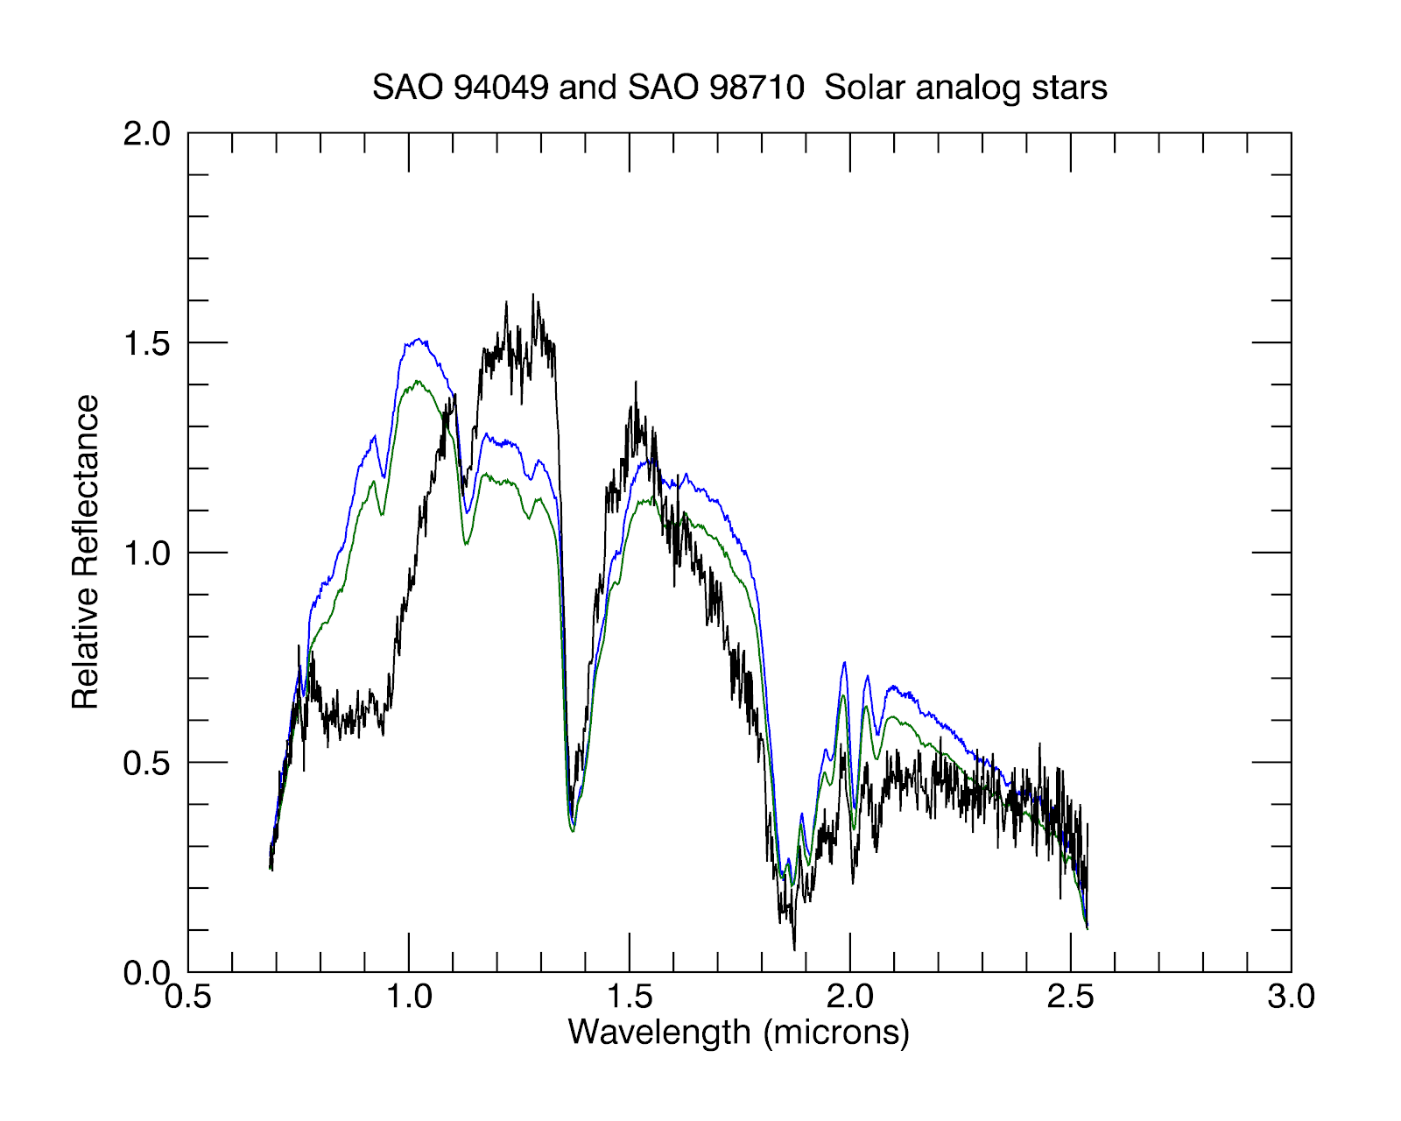
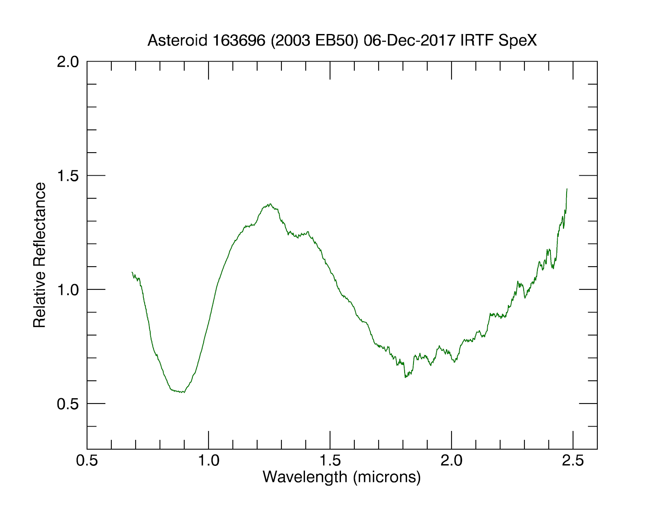


Before and After Calibration

Slide 8
Research Methodology
Primary Objective: Compile a list of reliable solar-analog stars spanning the sky
Verify that trusted solar analogs are consistent to each other
Compare potential candidates to trusted solar analogs

Slide 9
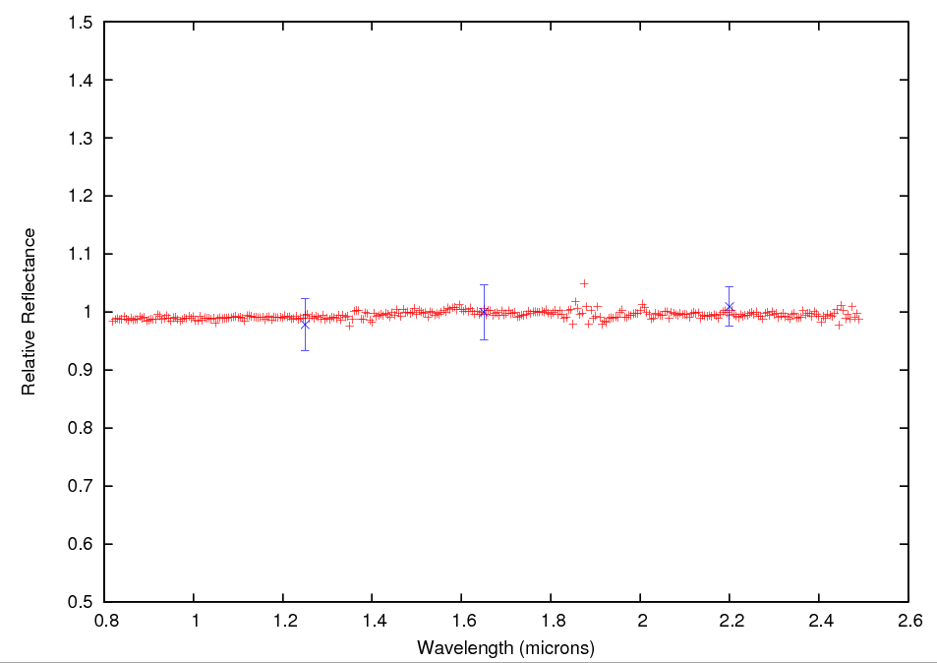
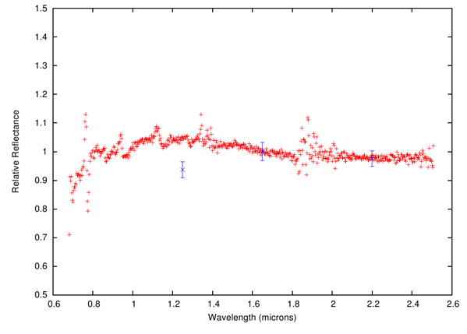
Example Figures
Excellent Analog Very Poor Analog

Slide 10

Current Findings
9 years of data from NASA Infrared Telescope Facility
  $\sim$700 observations of approx. 120 potential candidates
10-20% spectrally similar to the Sun and consistent over time
Publish entire star set with quality of each star as an analog for observers

Slide 11
Acknowledgements
Special thanks to:
  My mentor, Ellen Howell
  PI of OSIRIS-REx, Dante Lauretta
  NASA Space Grant Consortium
  Thank you for your invaluable guidance and the opportunities that have played a critical role in shaping my path as a researcher

